Slide 1
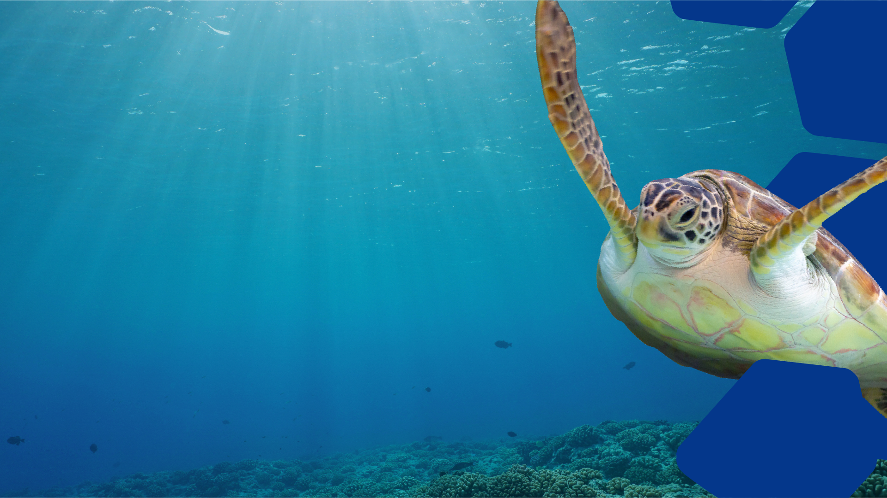
Incredible Sea Creatures
Pre-Visit Lesson Plan
EDUCATION

Slide 2
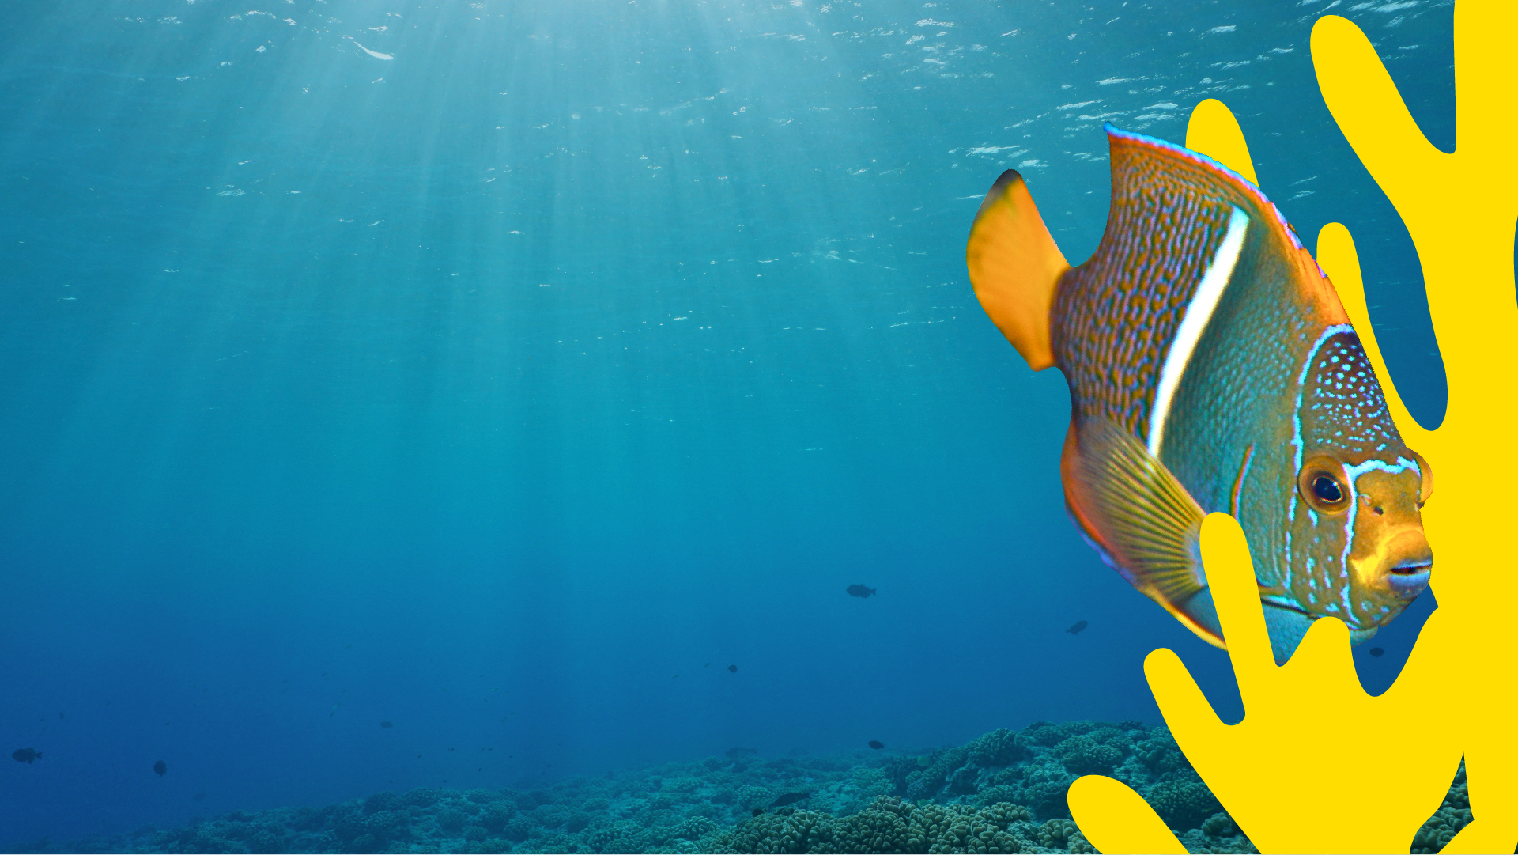
Objectives
To explore prior knowledge of sea creatures and the ocean
To compose a list of questions in preparation for the visit to SEA LIFE
To create Fact Cards for three core sea creatures
Outcomes
A table of known facts and questions about different sea creatures; three Fact Cards giving basic information about sea creatures along with drawings of each.
EDUCATION

Slide 3
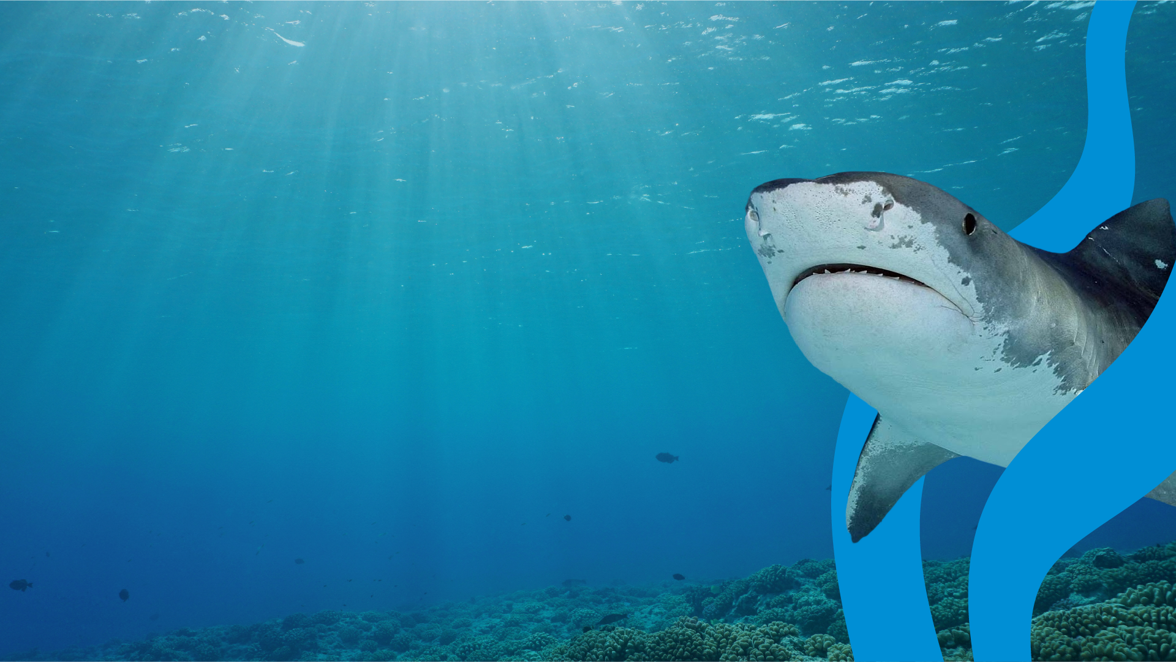
What do you already know about the ocean?
Have you ever visited an aquarium before?
EDUCATION

Slide 4
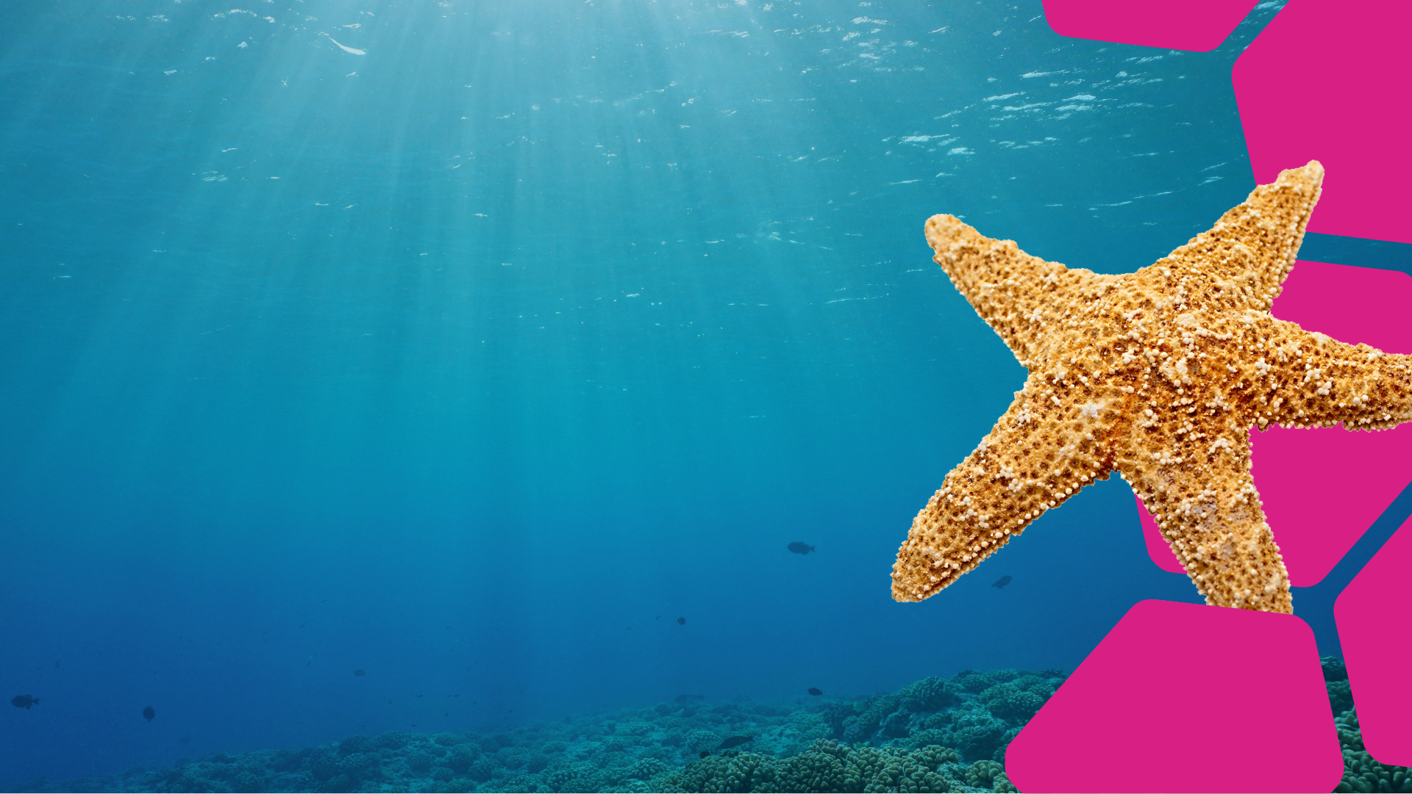
How many creatures that live in the sea can you name?
In 60 seconds write down as many as you can think of.
When your 60 seconds is up, swap lists with someone
near you and see how many on your lists are
the same.
You score a point for each answer you
thought of, UNLESS the other person
thought of it too!
The person
with the
most unique
sea creature
wins!
EDUCATION
Notes:
Younger students can work with partners to name as many animals out loud as they can – one point for every animal they name as a team!

Slide 5
Fill in the table below to prepare for your visit to SEA LIFE.
Which sea creatures do I know a little bit about?
What do I know about them?
What questions do I have about them?
Notes:
Younger students can be encouraged to draw/answer verbally instead of writing.

Slide 6
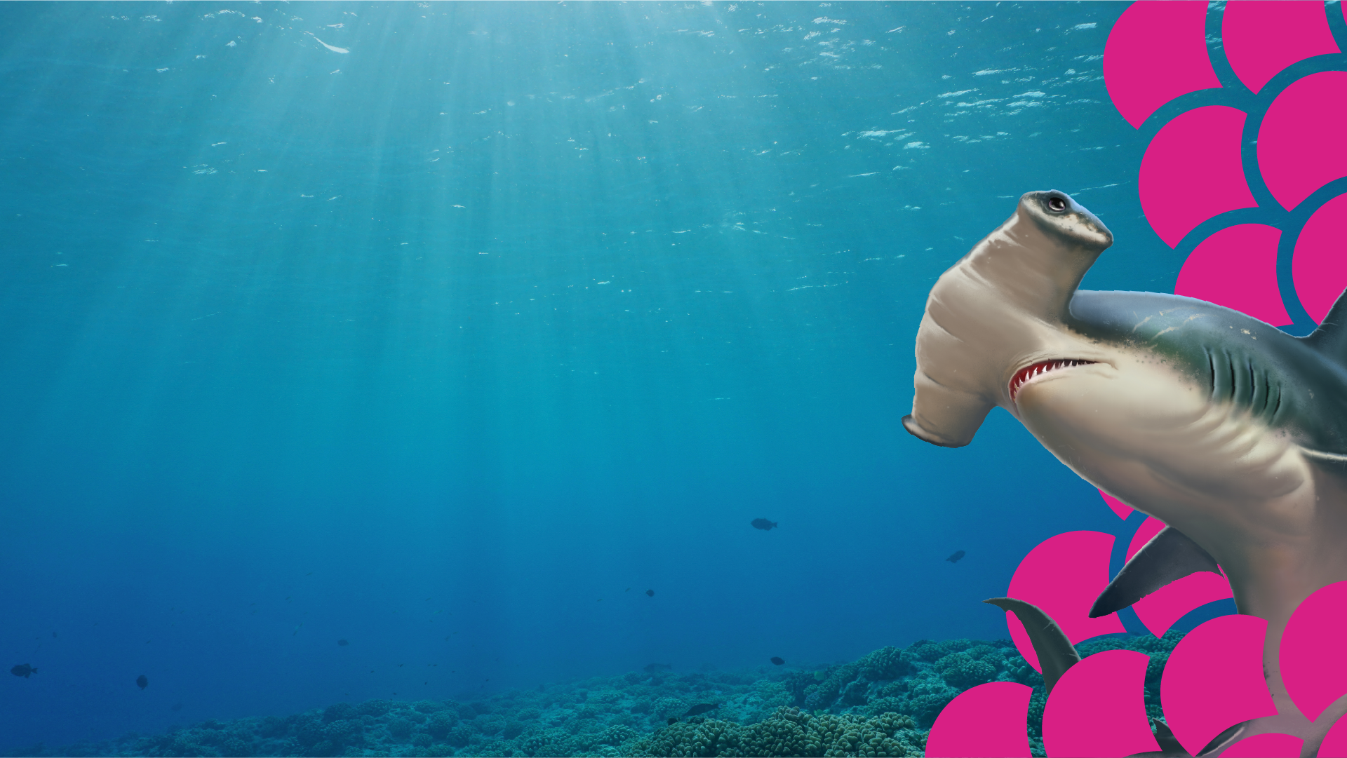
In pairs or as a class, read the descriptions below for three sea creatures
that you’ll be learning about on your visit to SEA LIFE. Discuss which
creature is your favorite and why. Which creature would you like to learn
more about?
Sharks:
There are around 500 known species of shark. They belong to a family of fish called Elasmobranchs and have been swimming our oceans for a whopping 420 million years! Sharks don’t have bones; their skeletons are made of cartilage – like our noses and ears! They also have lots of teeth – so many, in fact, that they have multiple rows! Some sharks, like the sand tigers, lose as many as 30,000 teeth in a lifetime. When they lose a tooth, one from behind moves forward and replaces it!
Seahorses:
There are around 35 known species of seahorse. From the biggest - the big bellied seahorse - to the smallest - the pygmy seahorse, which are just 2cm long (the size of your thumbnail), seahorses are amazing animals! The Greek name for seahorse is “Hippocampus”. If you break this down, “Hippos” means horse and “Kampos” means sea monster! And unlike humans, seahorses swim vertically.
Jellyfish:
Jellyfish are invertebrates, which means they have no spine. They also have no head, face, blood, heart or even a brain! The largest is the lion’s mane jellyfish of the North Atlantic, which has tentacles almost 100 feet long! Jellyfish are part of the group Cnidaria (ni-dare - ee – a) – the same as corals and sea anemones. There are more than 2,000 different types of jellyfish around the world; but scientists believe there could be as many as 300,000 more species just waiting to be discovered!
EDUCATION
Notes:
Younger students can read aloud as a whole group and discuss!

Slide 7
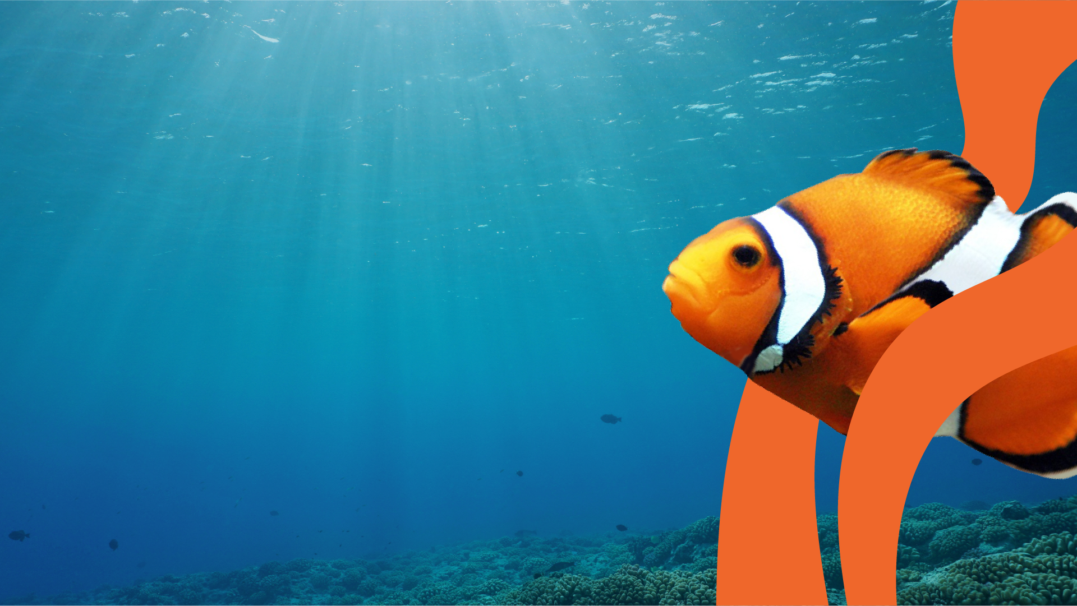
In your pairs, use the descriptions from the previous task to create some simple Fact Cards for these sea creatures. Use the categories below to create your cards – and remember to include drawings!
Number of different species
Family
Size
Interesting facts
Additional information
When you've made your Fact Cards, discuss which creature you think is the most interesting based on the work you did in the lesson. Are there any questions from the first task you haven't answered? Don't worry - you can go back to them during your experience at SEA LIFE, so make a note of them now!
EDUCATION
Notes:
Younger students can be encouraged to draw and discuss their ideas for Fact Cards out loud!

