Slide 1
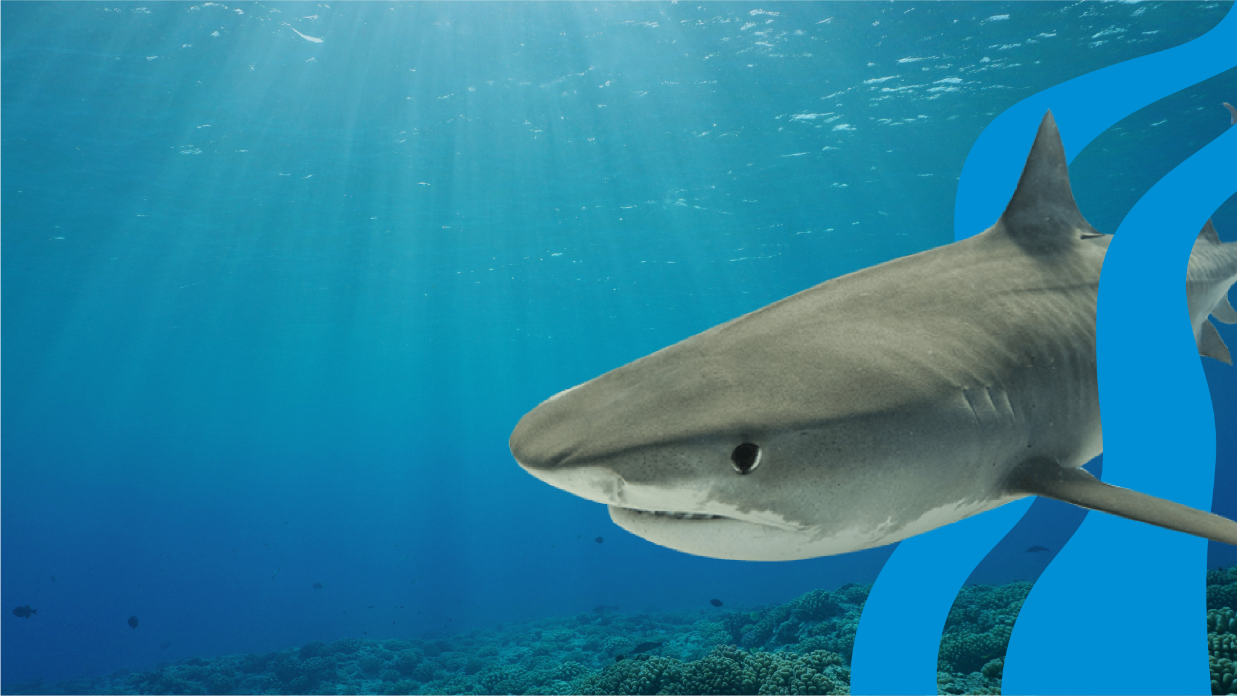
Layers of the Ocean
Pre-Visit Lesson Plan
EDUCATION

Slide 2
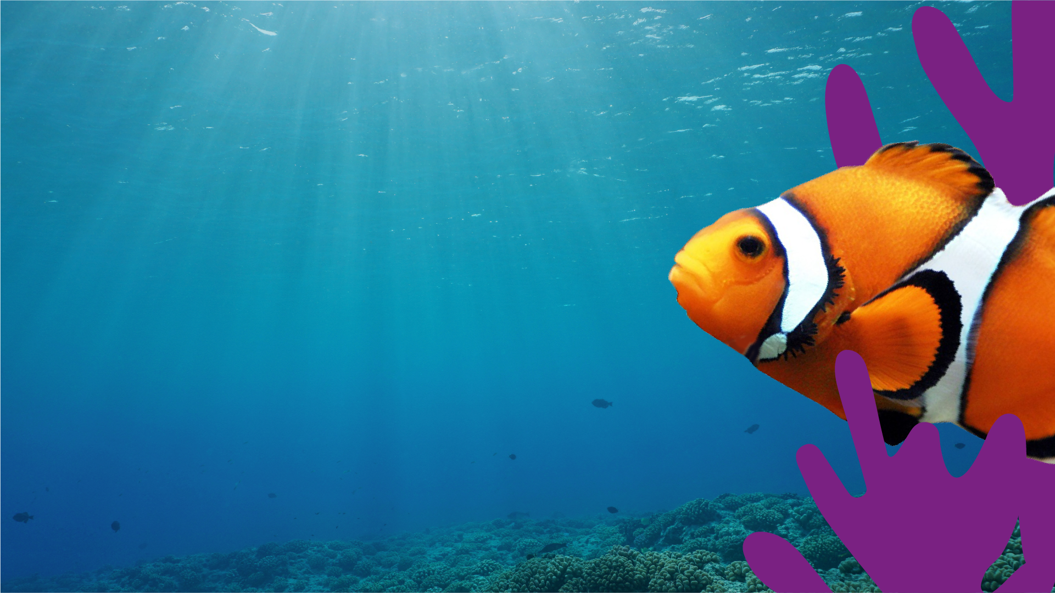
Objectives
To understand the ocean is very deep and made up of different ‘layers’ or ‘zones’
To create sensory maps based on how much light each ocean zone receives
To experiment with liquid density in order to create a layered ‘Ocean in a Jar’
Outcomes
Sensory maps for three ocean zones (surface, twilight and deep ocean); a completed ‘Ocean in a Jar’ consisting of three different liquids to represent three ocean zones.
EDUCATION

Slide 3
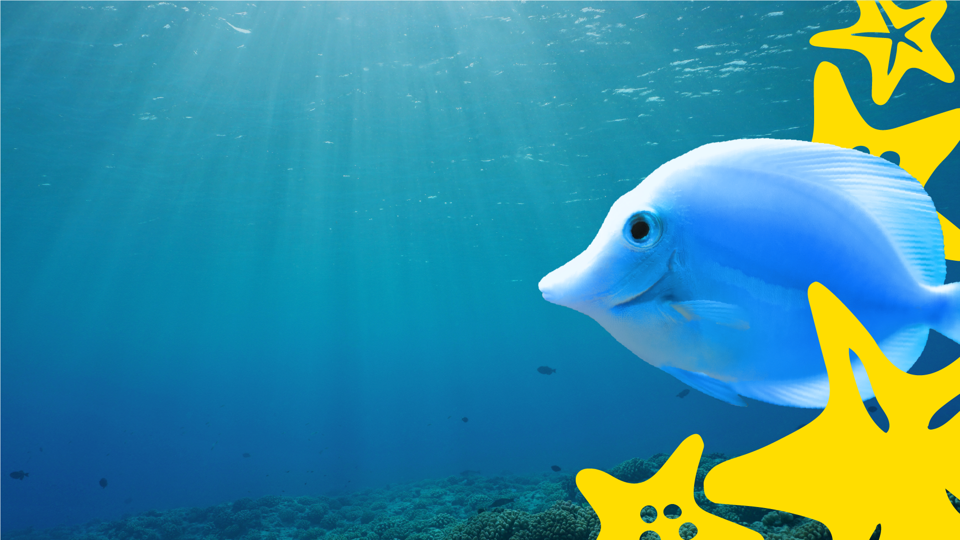
Have you ever been swimming in the ocean, how did it feel?
What do you know about life in the ocean?
EDUCATION

Slide 4
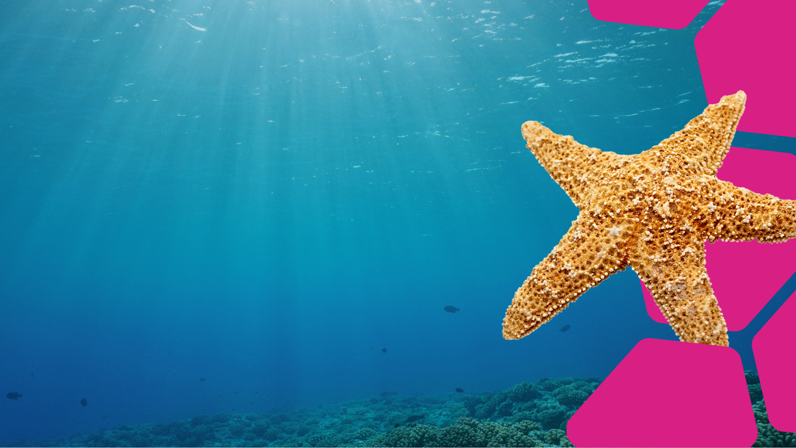
How deep do you think the ocean is?
Partner up with someone and make a guess in feet.
EDUCATION

Slide 5
ANSWERS
The average depth of
the ocean is almost
13,120 feet (4,000 meters).
That’s about the same
as 40 football fields
laid end to end!
EDUCATION

Slide 6
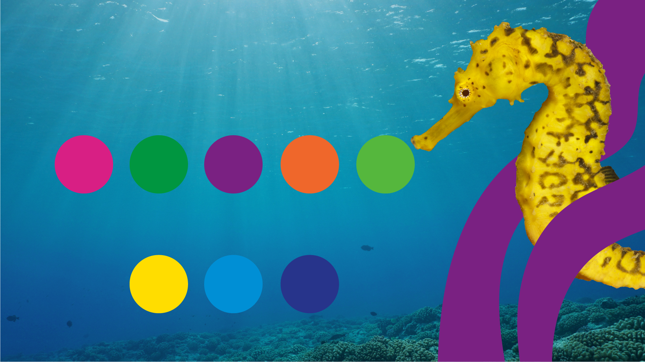
These layers can be found under the ocean. Put them in the order you think you'd go through them if you were diving from the surface down to the ocean floor.
Then for each layer, guess how it would differ to your five senses as you passed through it:
sight
touch
taste
smell
sound
Bear in mind that the depth of the ocean is characterized by the amount of light that each zone receives. These names should give you some clues:
Sunlight zone
Twilight zone
Midnight zone
There are a few more layers than this, but this is a good starting point!
EDUCATION

Slide 7
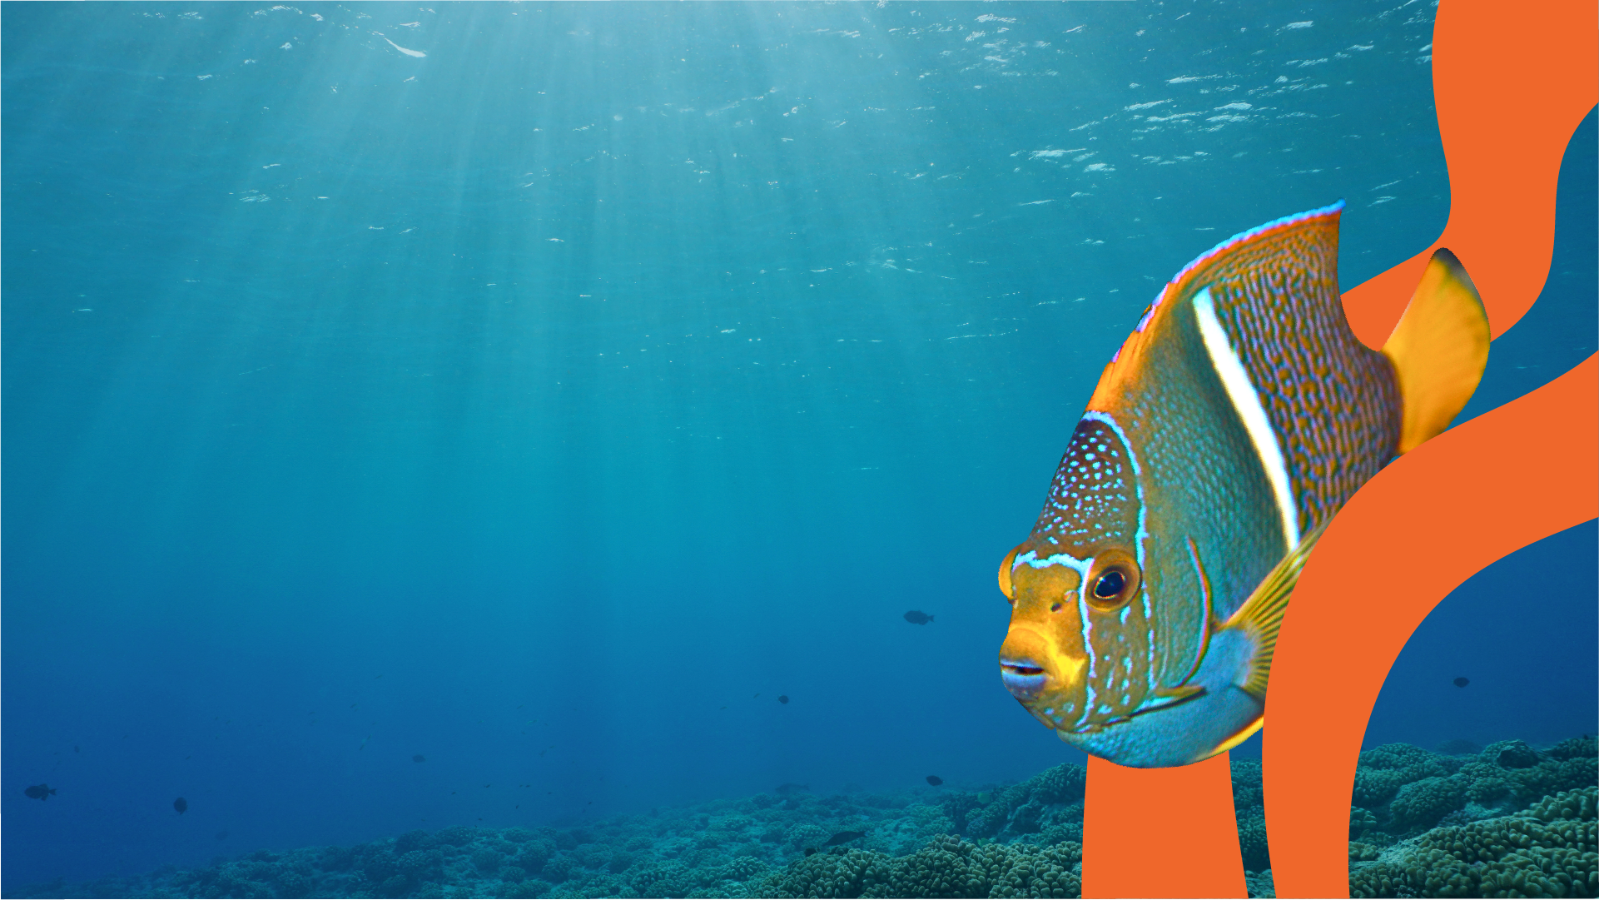
Time to recreate these three layers of the ocean (or ocean zones) by making a layered ocean jar! This activity is a combination of two science experiments: a lesson on liquid density while you'll also learn about ocean zones.
You will need:
An empty glass jar or water bottle
½ a cup of fine sand – if possible!
Water
Funnel
Black food coloring
Blue food coloring
Blue liquid soap
Corn syrup
EDUCATION

Slide 8
Method:
Use the funnel to pour ³⁄₄ cup of each liquid into your glass jar for each ocean layer (or less for a smaller jar).
Liquid 1: Add some black food coloring to ³⁄₄ cup of corn (dark) syrup at the bottom of the jar (this is the abyss!) This should be a deep black layer.
Liquid 2: Mix blue food coloring into ³⁄₄ cup of liquid soap (also preferably blue in color). Add to the jar using
a funnel (this is the twilight zone!) This should be a darker blue layer.
Liquid 3: Put blue food coloring into ³⁄₄ cup of water and use a funnel to slowly and carefully layer it on top of the washing up liquid (this is the sunlight zone!) This should
be a lighter blue layer.
EDUCATION

Slide 9
Write down the results of your experiment about the density of the different liquids you used!
Corn (dark) syrup
Liquid soap
Water
-
-
-
Abyss
Twilight zone
Sunlight zone
When you've finished, label each layer of your Ocean in a Jar with sticky labels!
Cool!
EDUCATION

