Slide 1
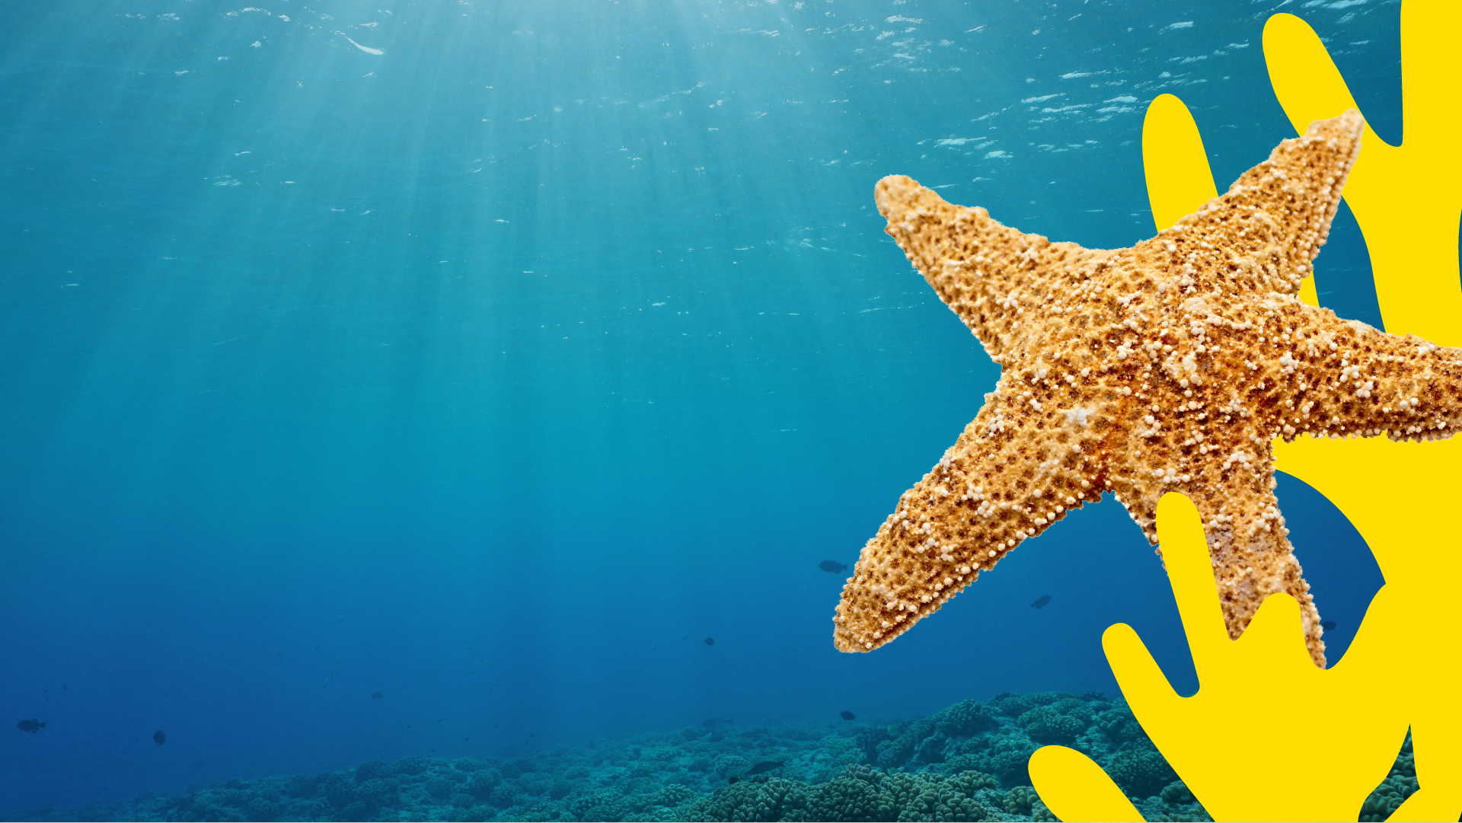

What the Ocean Means to Me
Pre-Visit Lesson Plan
EDUCATION

Slide 2
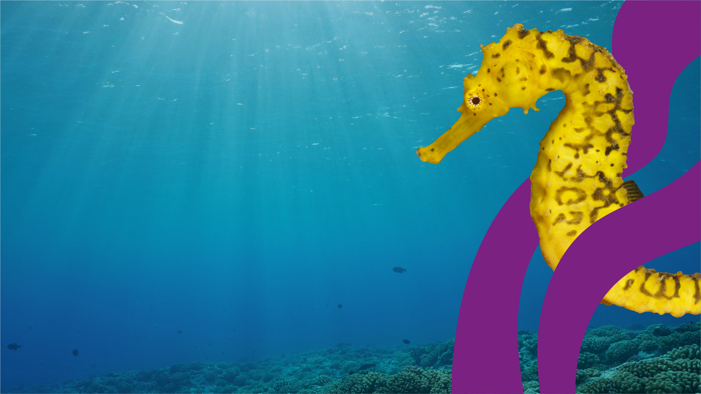
Objectives
To creatively explore what the ocean means to students on a personal level
To understand why it's important to protect the ocean
To create a persuasive, informative campaign poster for protecting the oceans
Outcomes
A poem and illustration entitled ‘What the Ocean
Means to Me.
A persuasive, informative campaign poster promoting
the need to recycle in order to protect our oceans.
EDUCATION

Slide 3
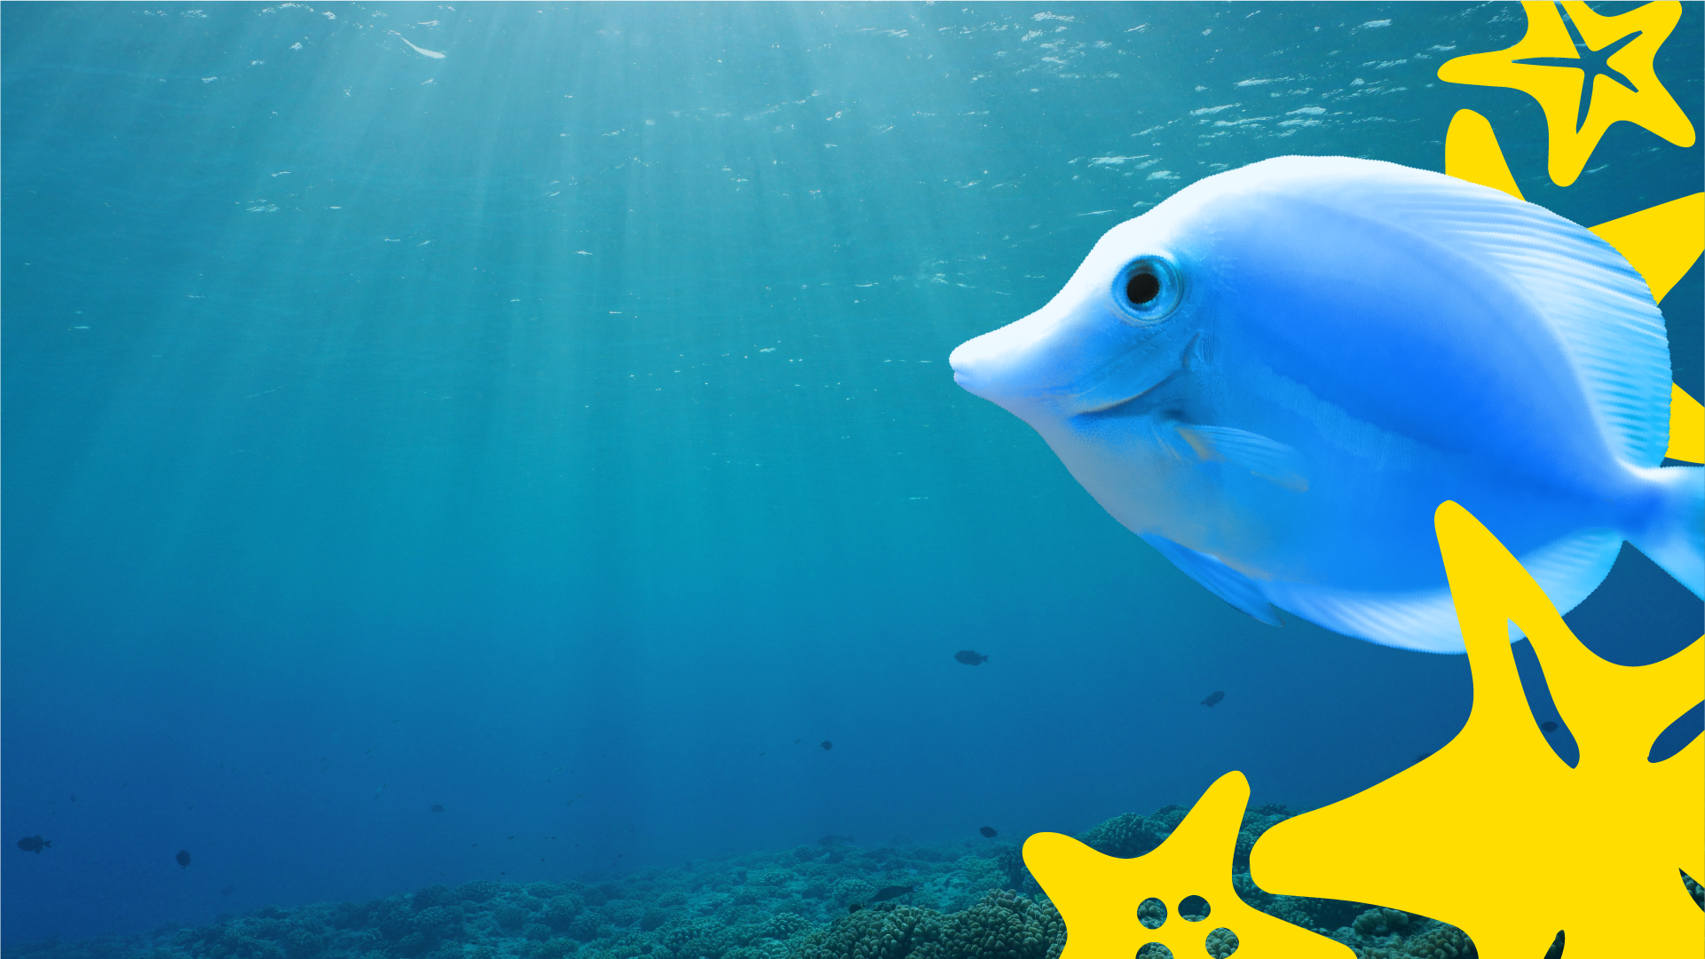
When did you last visit the ocean?
Where did you go?
What’s your best experience with or memory of the ocean?
What do you know about the ocean?
EDUCATION

Slide 4

What does the ocean mean to you?
Make a list of words that come into your head when you think about the ocean.
You can
even use your
words to make
a creative
classroom
display

Slide 5

Use this template to write a poem and create a drawing to show what the ocean means to you.
My Ocean Poem:
My Ocean Drawing:
Consider
reasons why
the ocean
should be
protected

Slide 6
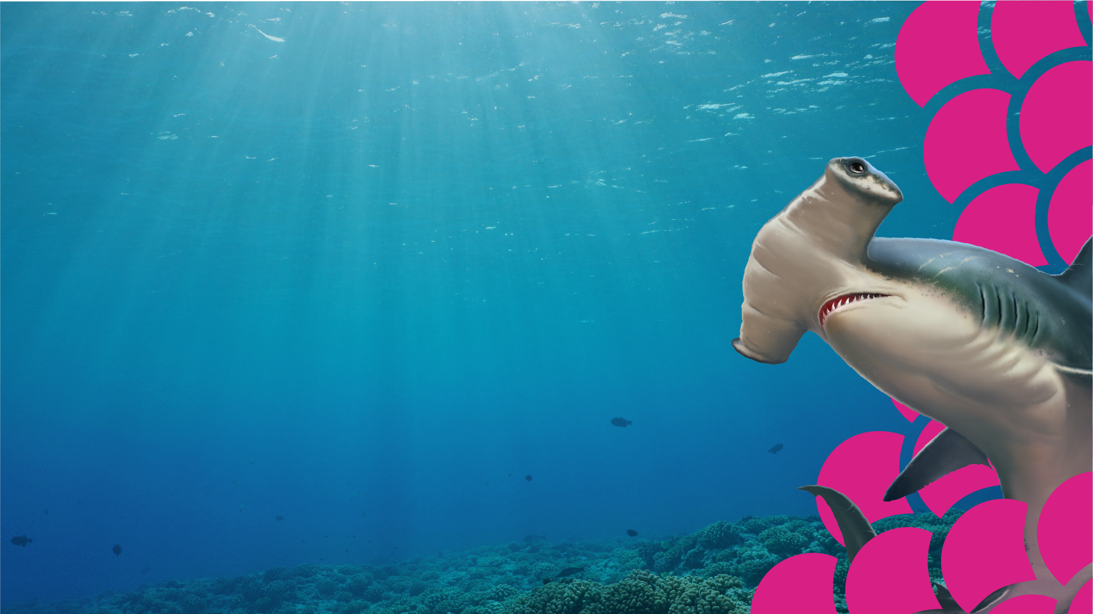
Discuss with a partner:
What is recycling?
Why does it have a good impact on our oceans?
How does it help to protect them?
Now make a bullet point list of all the reasons why you think we should recycle more. Try to come up with at least five reasons before sharing your list with the rest of the class.
Reasons why we should recycle are…
EDUCATION

Slide 7
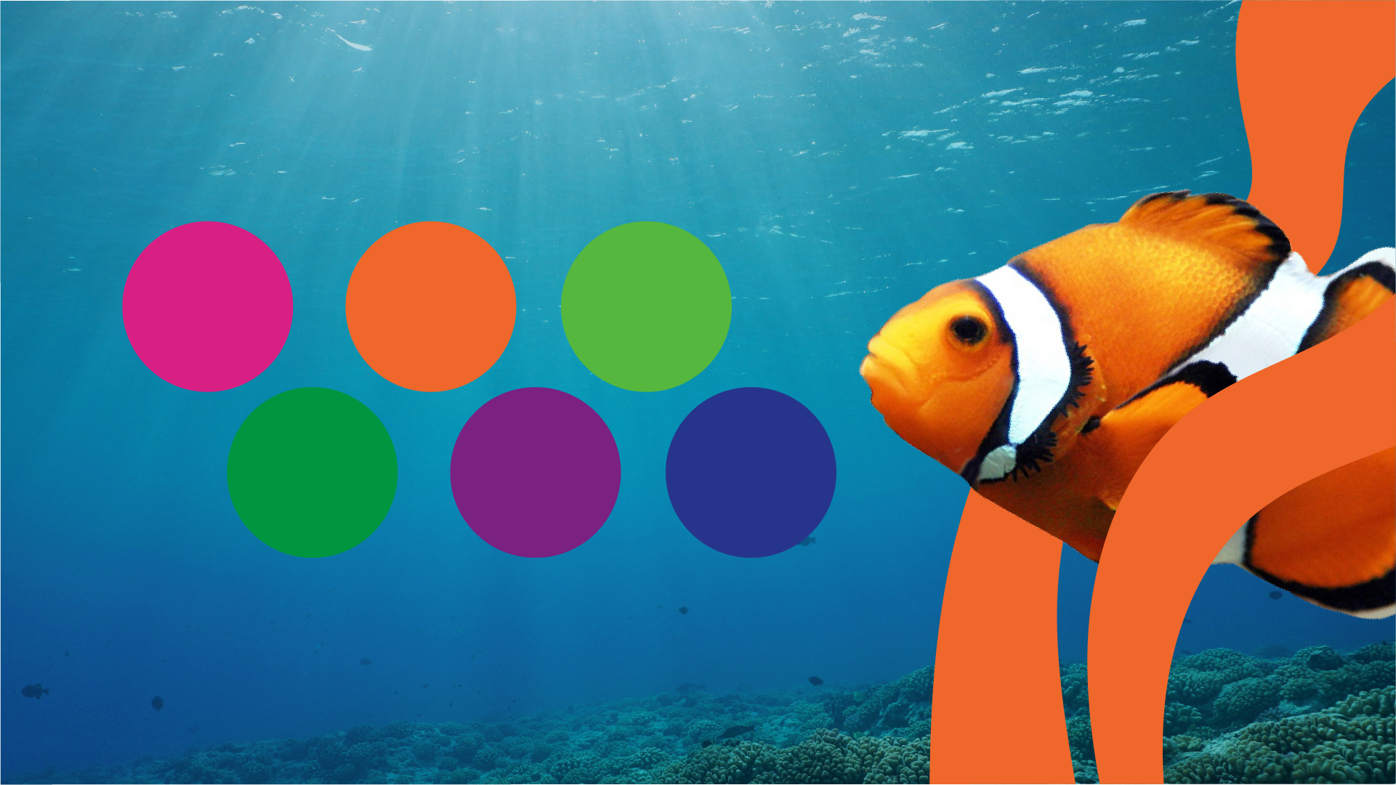
In pairs, look at the following factors that make a good campaign poster.
Strong
bold
colours
A catchy
campaign
slogan
Real life
examples
Persuasive
language
and
techniques
Informative
language
Images
Discuss each one and give reasons why it is important.
Then put them in order of importance from most to
least, giving reasons for your choices.
EDUCATION

Slide 8

Thinking about the factors that make a good campaign poster, now it’s your turn to make one!
Create a campaign poster explaining why we should recycle our waste, and
persuading people to change their attitude
towards waste in order to protect our oceans.
Appeal to
their emotions
by sharing
what the ocean
means to
you.

